Slide 1
DEPARTMENT OF HEALTH
RESEARCH INSTITUTE FOR TROPICAL MEDICINE
Best Practices for Scientific Sustainability in a Research Institution
Mario Jiz, PhD
Chair, Research and Innovation Office
Head, Immunology Department
Research Institute for Tropical Medicine
12th PNHRS Week
Baguio City, 9 August 2018

Slide 2
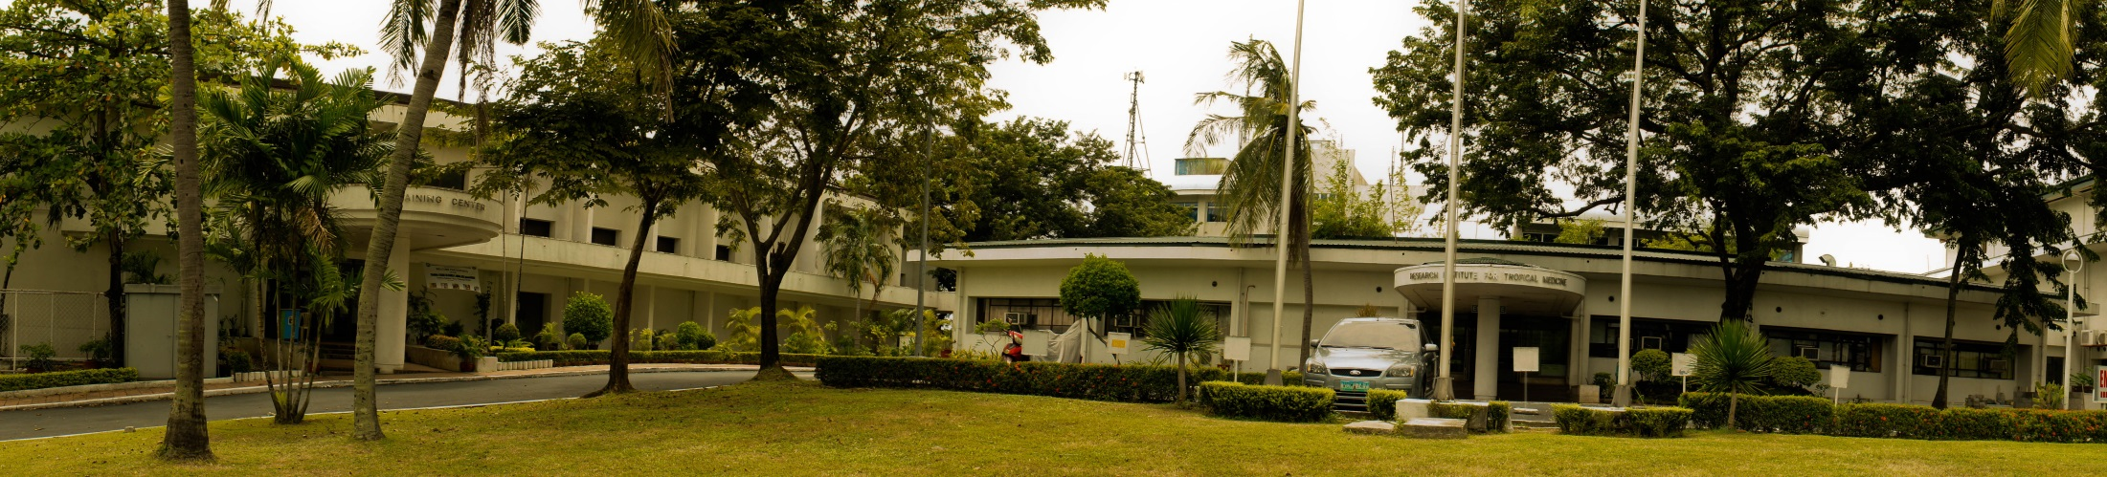
Research Institute for Tropical Medicine
Established 1981 in Alabang, Muntinlupa City
Attached agency of the Department of Health
Primary mandate to conduct globally competitive research on infectious and tropical diseases
Conducts training, clinical care, reference laboratory services and biologicals production for the prevention and control of infectious and tropical diseases of public health importance to the Philippines

Slide 3
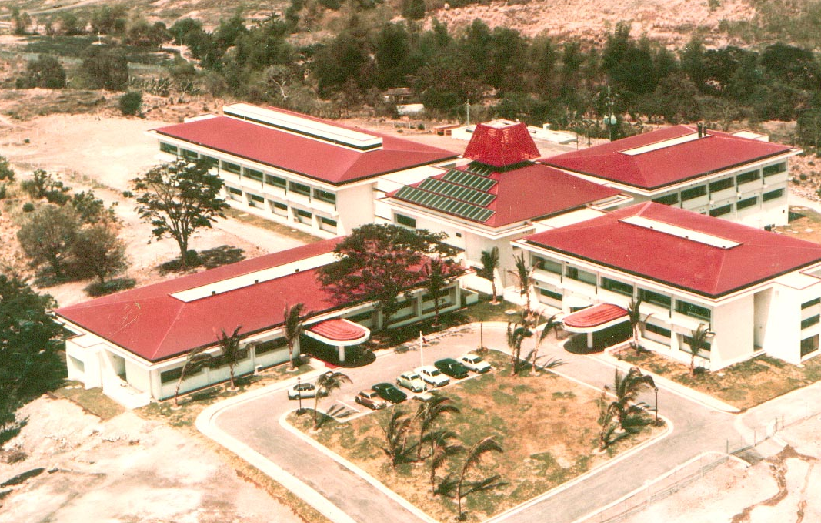
Public Health Research
RITM
Clinical
Trials
Tertiary
Healthcare for Infectious Diseases
Training
Courses
Executive Order 674, 1981

Slide 4
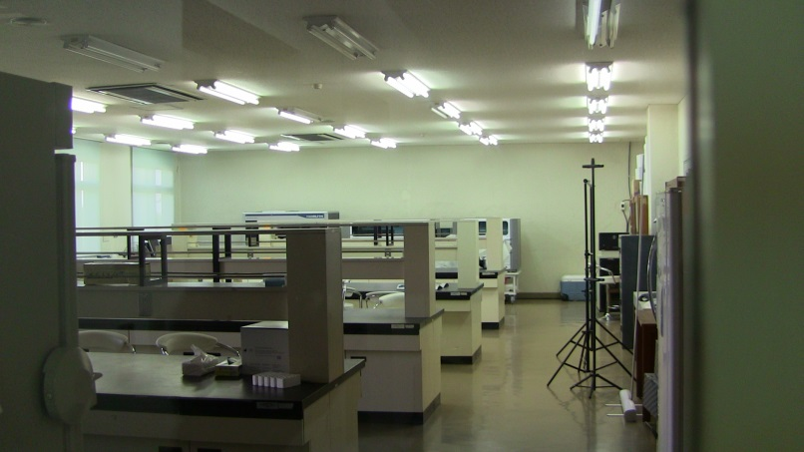
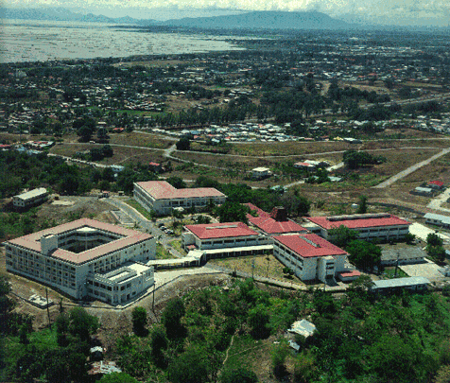
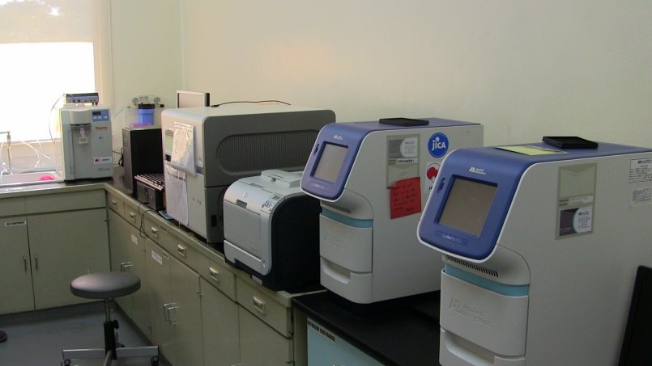
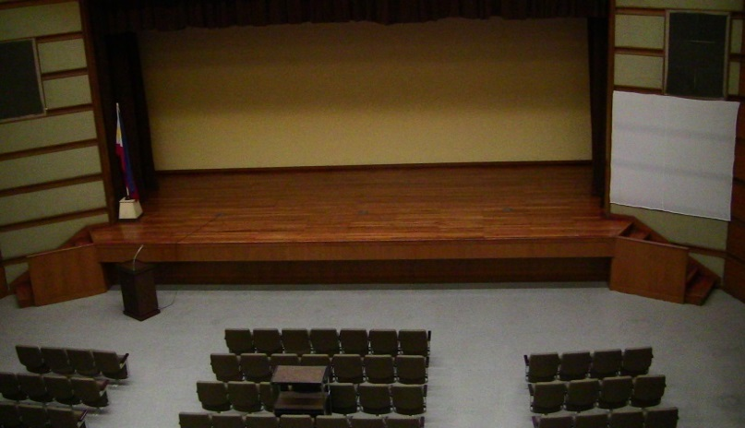

Slide 5
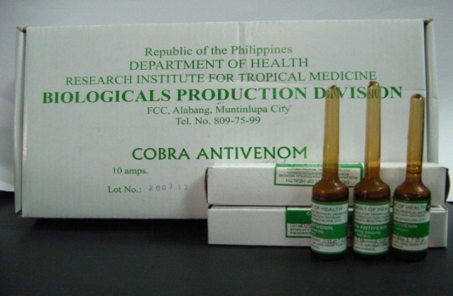
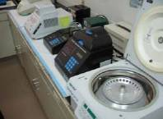
Responsibilities
  Main research arm of DOH for infectious and tropical diseases (1981)
  National Reference Laboratories for infectious disease (2000)
  Designated Referral Hospital for Emerging and Reemerging Infections (2003)
  Biologicals production, storage and distribution of EPI vaccines in the country (1998)
  WHO TDR Regional Training Center
  for Good Research
  Practices

Slide 6
Emerging Infections in the Philippines
2015
▼
MERS CoV, Ebola Reston
2014
▼
Measles, MERS CoV, Henipah, Ebola?
2013
▼
Pertussis, Measles
2012
▼
Leptospirosis
2011
Chikungunya
▼
2010
▼
Dengue
2009
▼
Pandemic A H1N1
2008
▼
Ebola Reston in pigs and humans/ Leptospirosis/ Salmonella typhi
2007
▼
Resistant Shigella flexneri 2a in Cavite, Bohol and Cotabato
2006
2005
2004
▼
Meningococcemia outbreak in CAR
2003
▼
SARS Outbreak
2002
▼
West Nile Virus Pseudo outbreak (RITM as Referral Laboratory)
2001
▼
Bioterrorism threat using Bacillus anthracis as biological weapon
1998
▼
Serological Surveillance ABLV
1996
▼
Ebola Reston in monkeys (US)
1992
▼
Ebola Reston in monkeys (Sienna, Italy)
1989
▼
Ebola Reston in monkeys (Reston, Virginia)
Notes:
SARS in 2003 – wake up call that a new deadly disease can emerge
Lab preparedness in 2005 for a pandemic inluenza much like the 1918 Spanish flu when Avian flu appeared in many neighboring countries
Pandemic A H1N1 – tested the biopreparedness plan and system

Slide 7
Laboratory Research Division
Microbiology
Virology
Parasitology
Immunology
Molecular Biology
Pathology, including Clinical Lab, EM & TTI-NRL
Veterinary Research, including Special Pathogens
Antimicrobial Resistance Reference Lab
TB Reference Lab

Slide 8
Clinical Research Division
Medical Department
50 bed capacity tertiary hospital for infectious diseases
8 negative pressure rooms, 2 ICU for highly infectious pathogens
Rabies confinement
Hospital support (Nursing, Dietary, Pharmacy etc)
Epidemiology and Biostatistics, including Library

Slide 9
Study Groups
Acute Respiratory Infections
Diarrhea
Schistosomiasis
Dengue
HIV / AIDS
Tuberculosis
Malaria
Leprosy
Rabies
Hepatitis
Medical Department

Slide 10
Institutional Review Board & RIO
FERCAP recognized & PHREB Level III accredited
11 members (5 MD, 2 PhD, 4 Lay members)
Institutional Research Policy
Research & Innovation Office
Strengthen research capacity of RITM investigators
Knowledge management

Slide 11
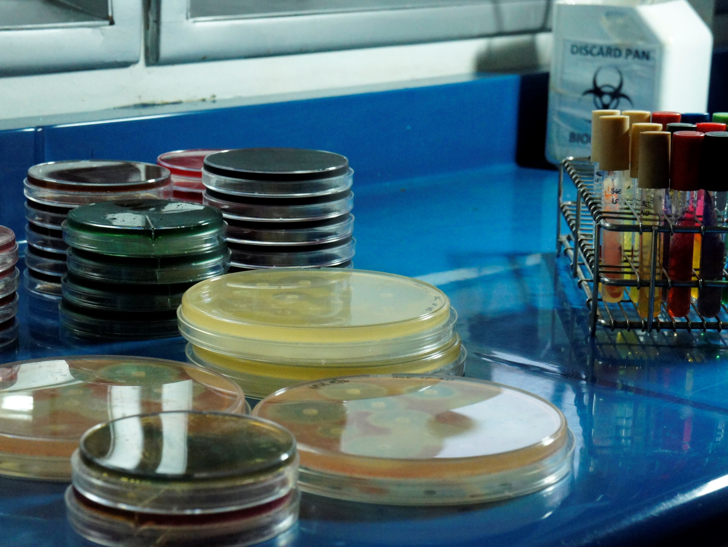

Key Achievements
Translation of research output to public health policies
Over 500 publications in peer-reviewed international journals
Rapid laboratory response to outbreaks and pandemic threats
Clinical expertise in management of infectious and tropical diseases
Established and expanded formal linkages with local and international institutions

Slide 12
Ongoing Researches
89 research projects
63 investigator-initiated
  33 basic biomedical research
  28 operations research
26 sponsor-initiated, both DOH/WHO-commissioned & private
  15 are industry sponsored clinical trials

Slide 13
Challenges
Lack of institutional research funding
Dependent on highly competitive funding process and on commissioned grants, both public & private
Brain drain
Equipment and facilities
Laboratory and clinical trial space
Human resource competency

Slide 14
Research funding
Capacity building for investigator initiated research
  Journal access
  Grant proposal and protocol writing
Collation and dissemination of funding opportunities (twice monthly RIO Newsletter)
Local funding through the Philippine Council for Health Research & Development
Strengthen and expand collaboration with international research and academic institutions

Slide 15
Funding Agencies
US National Institutes of Health
Centers for Disease Control and Prevention
Japan International Cooperation Agency
UK Medical Research Council
Australian National Health Medical Research Council
USAID, AUSAID
WHO Tropical Disease Research
Bill & Melinda Gates Foundation
American Foundation for AIDS Research
Global Fund for TB, Malaria and HIV
Funding agencies in Canada, France, China etc

Slide 16
Industry funding and collaboration
GlaxoSmithKline
Takeda
Sanofi-Pasteur
Pfizer
LG Chem
Non-profit
International Vaccine Institute
PATH

Slide 17
Research Funding
Internal research funds
  Research Policy mandates Institutional Fee
  6 small research grants in 2017
  5 grants in 2018, out of 10 submissions
  P 300,000 for one year projects
  Personnel and supplies

Slide 18
Lobby for institutional research support
Health Policy Development and Planning Bureau
  Facilitated by the HPDPB Research Division
  >20 proposals from the various study groups
  for evaluation by the RITM executive committee & submission to HPDPB
  2% DOH budget allocation for research

Slide 19
Human Resource
Incentivise researchers through honoraria
  Local researchers do more work than international collaborators, but are inappropriately compensated
  DBM-DoF-COA circular on international projects respecting the approved budget
  Challenging for publicly funded research (25% cap)
Scientific career system
Recognition (PRAISE Committee)
  Publication award, international research award

Slide 20
Investments in Human Resource
Capacity building
  Manuscript writing
  Policy brief workshop
  GCP and ethics training
  Project management and implementation
  Dissemination of scholarship and fellowship opportunities
WHO TDR Regional Training Center for Good Research Practices

Slide 21
Investments in Human Resource
Research-nurturing environment
  Monthly brown bag lectures
  Research symposia for visiting scientists
  Annual Research Conference
  Support for local conference travel of accepted abstracts
Dedicated time (Writing leave) for proposal and manuscript development
Support for publication fees ($$$ per page)

Slide 22
Institutional Resources
Epidemiology & Biostatistics
  Study design, data collection tools, data management, sample size calculation, statistical analysis
Molecular Biology core facility
  Conventional and real-time PCR, Sanger sequencing, Next Generation Sequencing
Immunology core facility
  Monoclonal antibody production, antigen production and purification, ELISA, peptide mass fingerprinting
Pathology (Histopath, EM)

Slide 23
Setting directions
Institutional Research Agenda
  RITM Research Agenda established 2017, reviewed in 2018
  64 research topics from the study groups and departments
  Aligned with NUHRA and DOH research agenda
  Close coordination with Program Managers
Research targets in Quality Management System
  IPCR targets for ongoing IRB-approved research projects, proposals submitted, publications
  Semi-annual review

Slide 24
Future-proof
Lobby for & acquire advanced technologies
Expansion of research spaces

Slide 25
Summary
Funding opportunities are available for quality, timely and relevant research proposals
Strength in collaboration
Human resource is our greatest asset
Shared responsibility to establish a nurturing and productive environment for researchers

